Slide 1

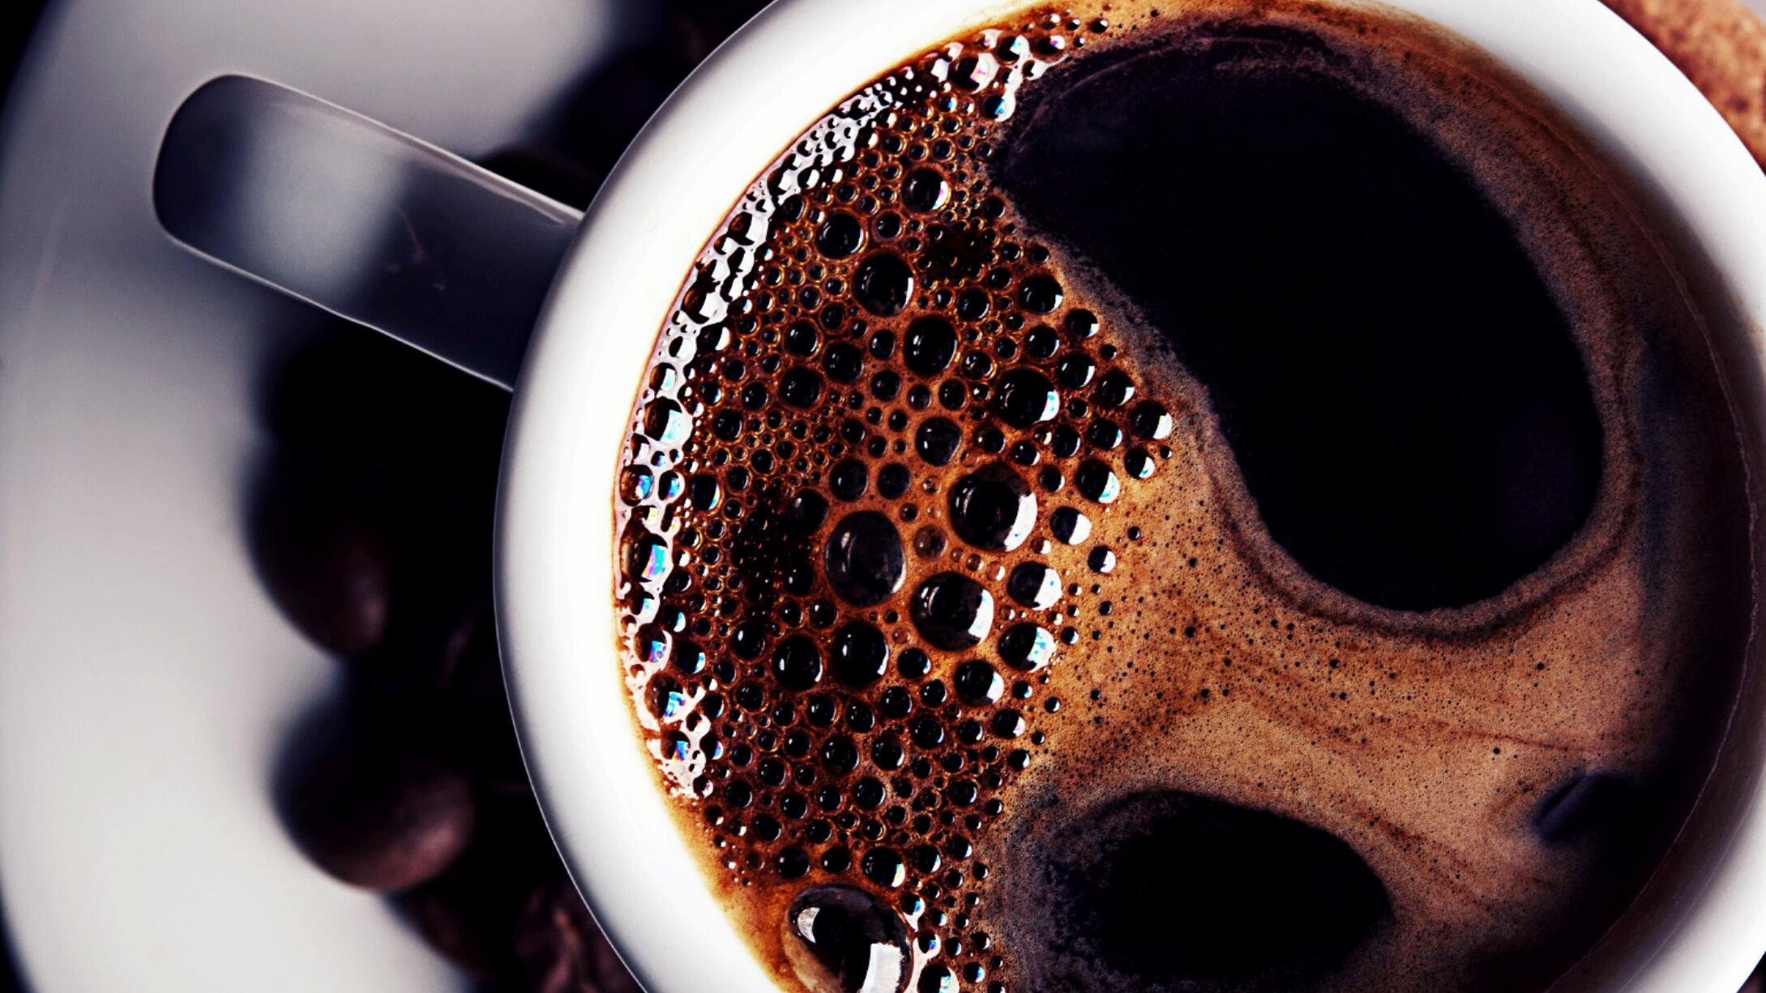
BigData Challenge 2022
Dragon Team

Slide 2
Image Encryption and Decryption
Encryption
Arnold’s cat map
Chen’s chaotic system
Decryption
Approach 1: parameter estimation
Approach 2: deep learning based attack

Slide 3
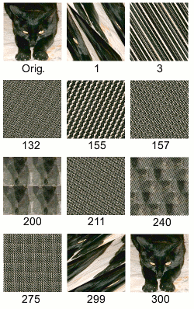
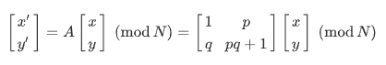
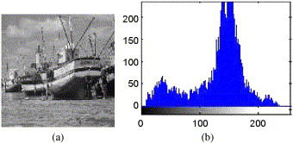
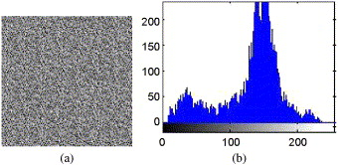
Arnold’s cat map
3 parameters p, q, M
Repeat the following process in M times
Input and color histogram
Output and color histogram

Slide 4
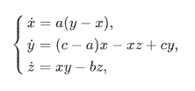
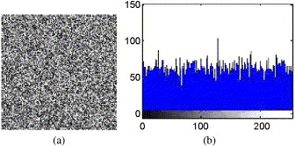
Chen’s chaotic system
3 parameters a, b, c???
Repeat the following process in K times
Input and color histogram
Output and color histogram

Slide 5
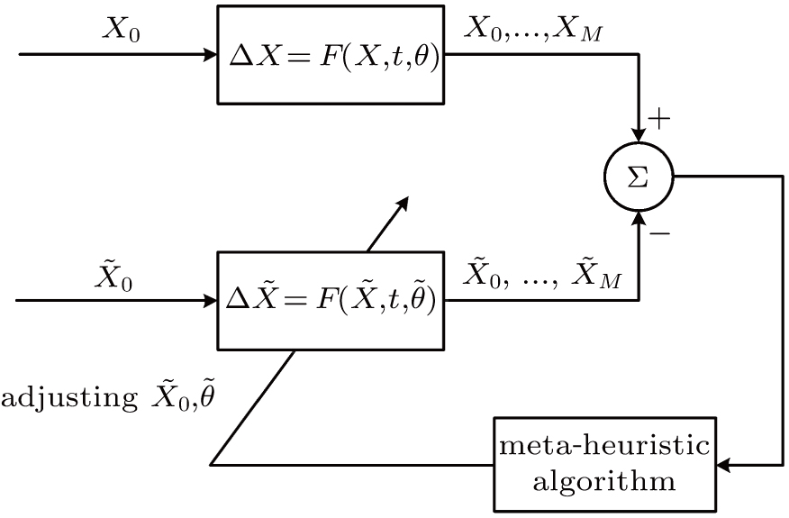
Decryption 1: parameter estimation

Slide 6
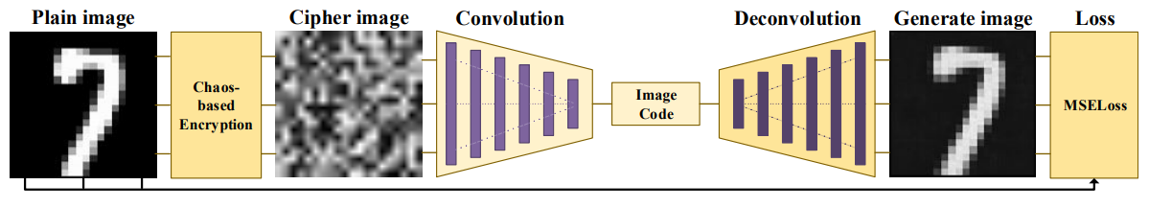
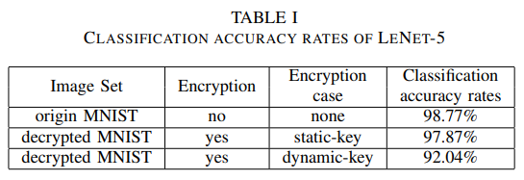
Decryption 2: deep learning based attack

Slide 7
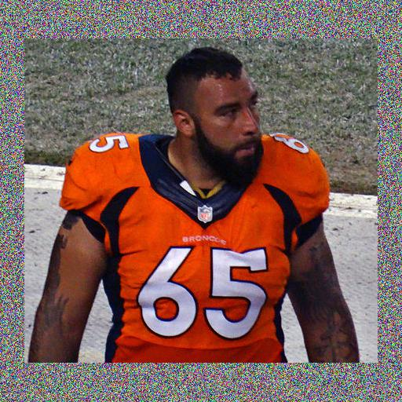


Our challenges
Binary file
image
encode
image
encode
Task 1, 2
Task 3

Slide 8
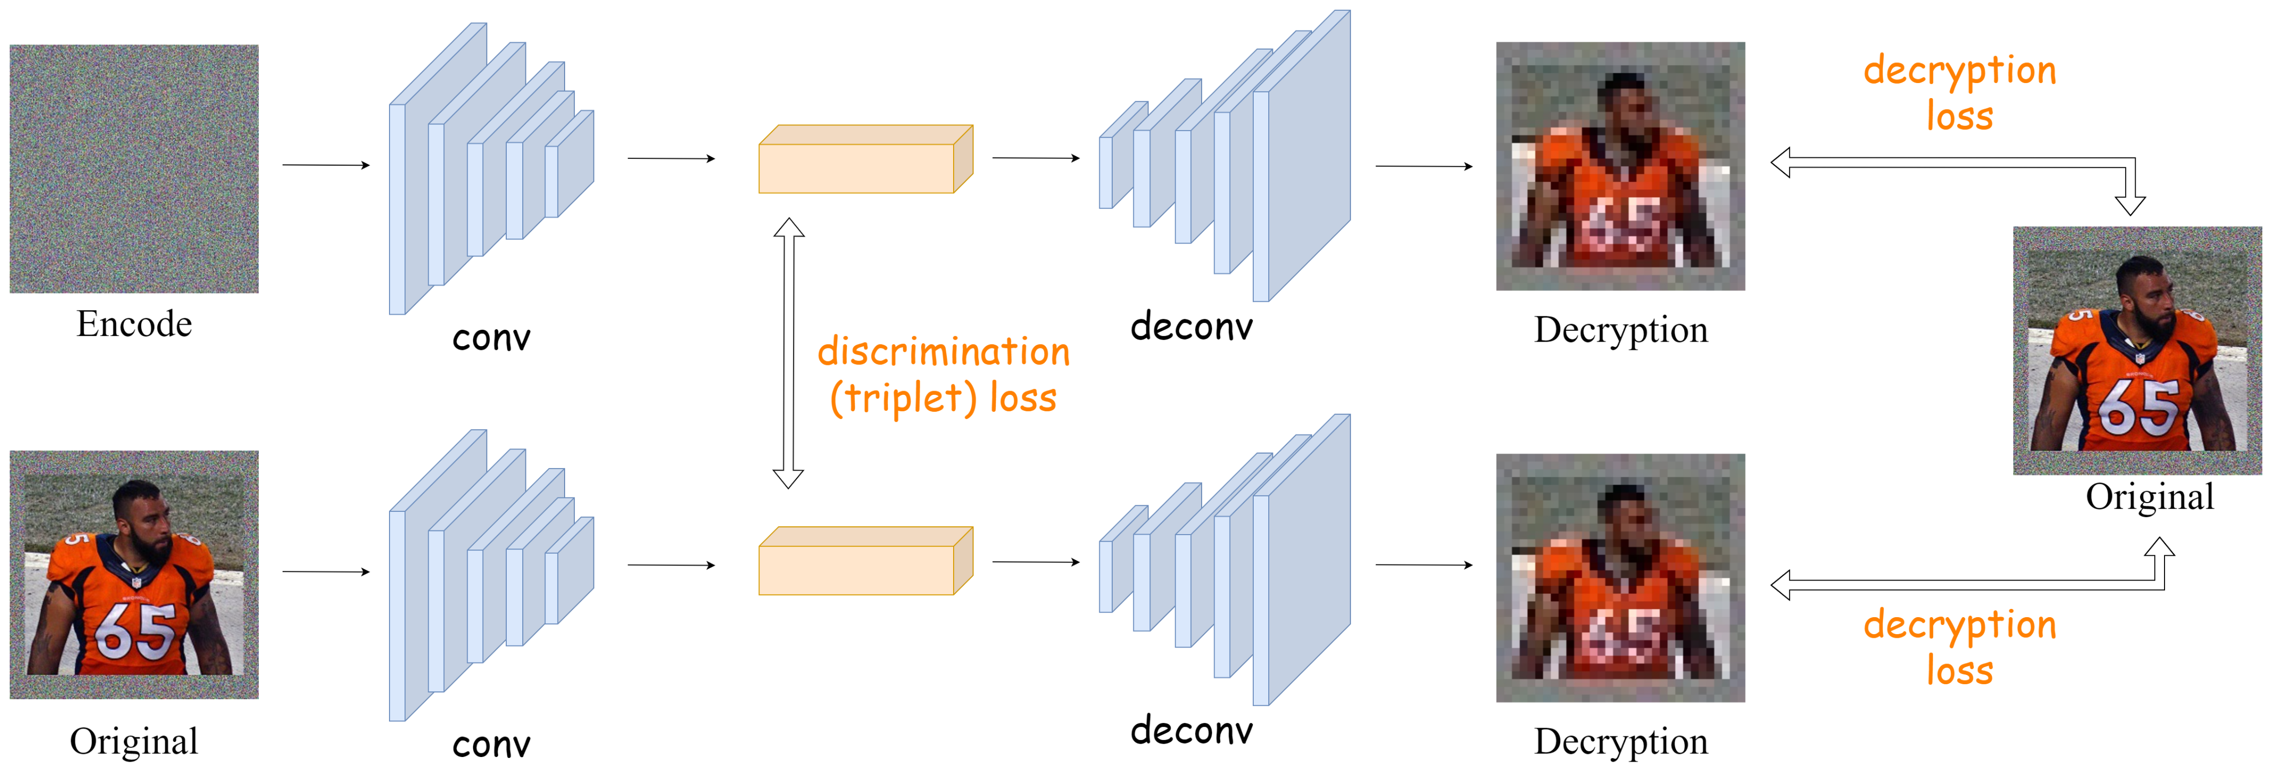
Task 1, 2
FPN

Slide 9
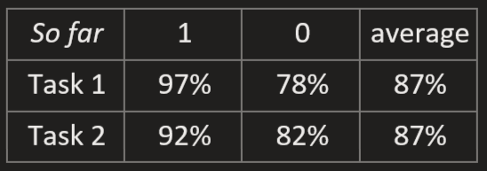
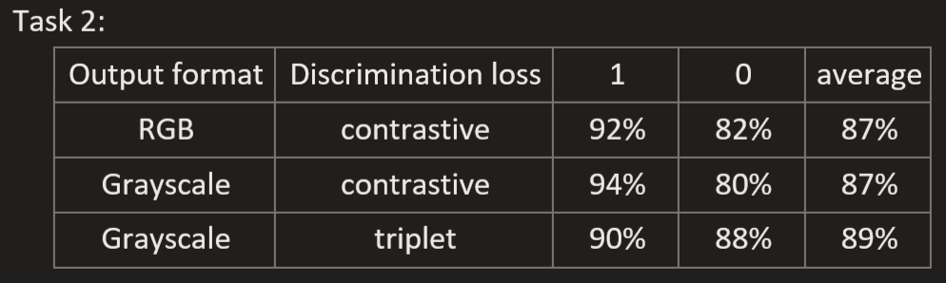
Task 1&2 results

Slide 10
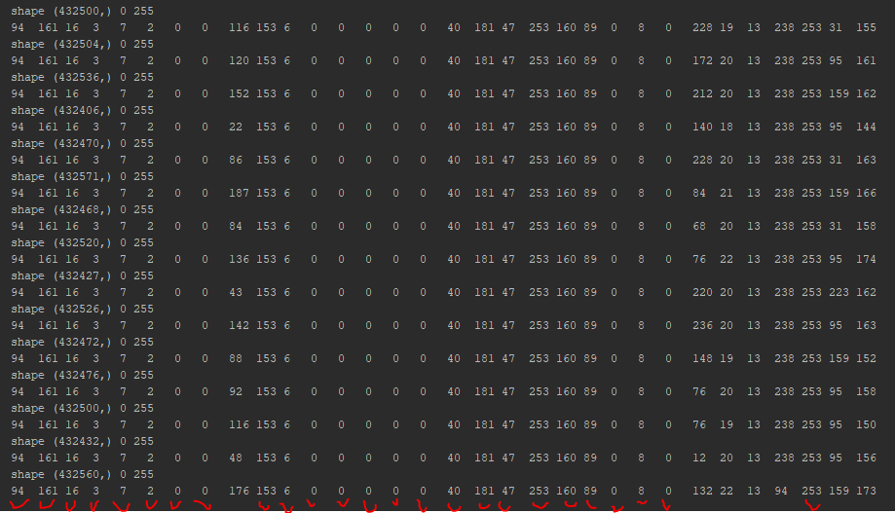
Task 3
Binary files:
Shape
Min value
Max value
Reveal the first 32 values

Slide 11
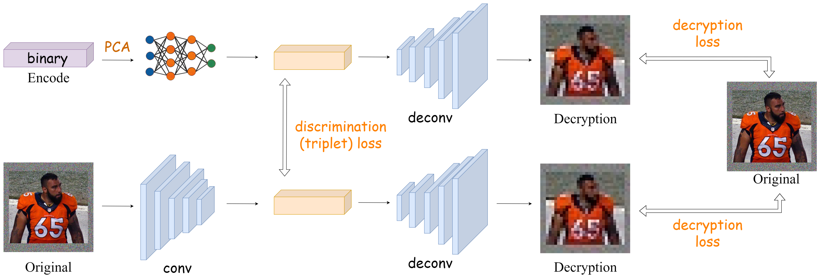
Task 3 – proposal network

